Slide 1
Celonis Exercise Solution
Exercise Sheet 2: Create a custom Dashboard

Slide 2
Exercise 2 Overview
In this task, you take the role of a process analyst. Your goal is to create a Dashboard that visually presents an overview over the topic “Throughput times and bottlenecks”.
For that purpose, we analyze the given (reduced) financial event log of a real-world loan application process¹. If you haven’t already done so for Exercise 1, start by uploading it to Celonis following the Introduction to Celonis slides.
¹Adapted dataset (with the 612 most frequent variants) from: van Dongen, Boudewijn (2012): BPI Challenge 2012. Version 1. 4TU.ResearchData. dataset.
https://doi.org/10.4121/uuid:3926db30-f712-4394-aebc-75976070e91f

Slide 3
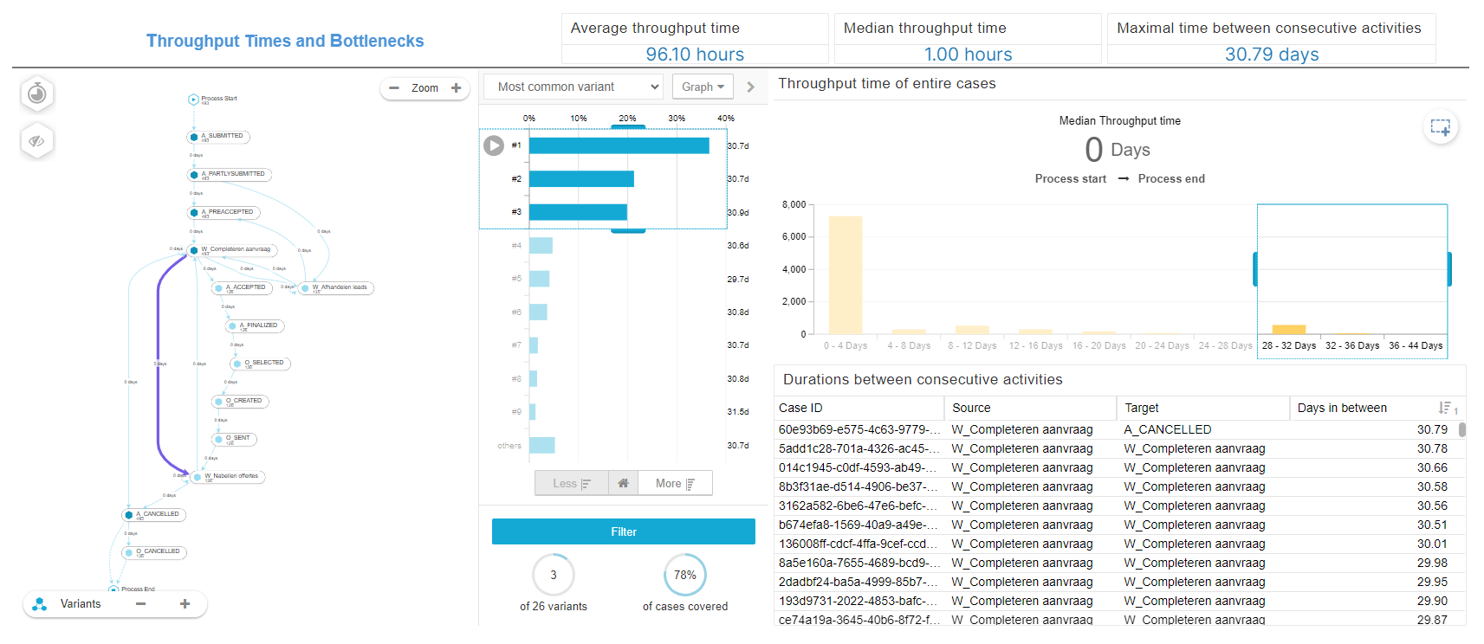
Solution – Exercise 2

Slide 4
Solution – Exercise 2
This is roughly how your dashboard should look like when it’s finished. If you couldn’t get all of it right, don’t worry. In the following, we will show you the solution how to set up the dashboard step-by-step.

Slide 5
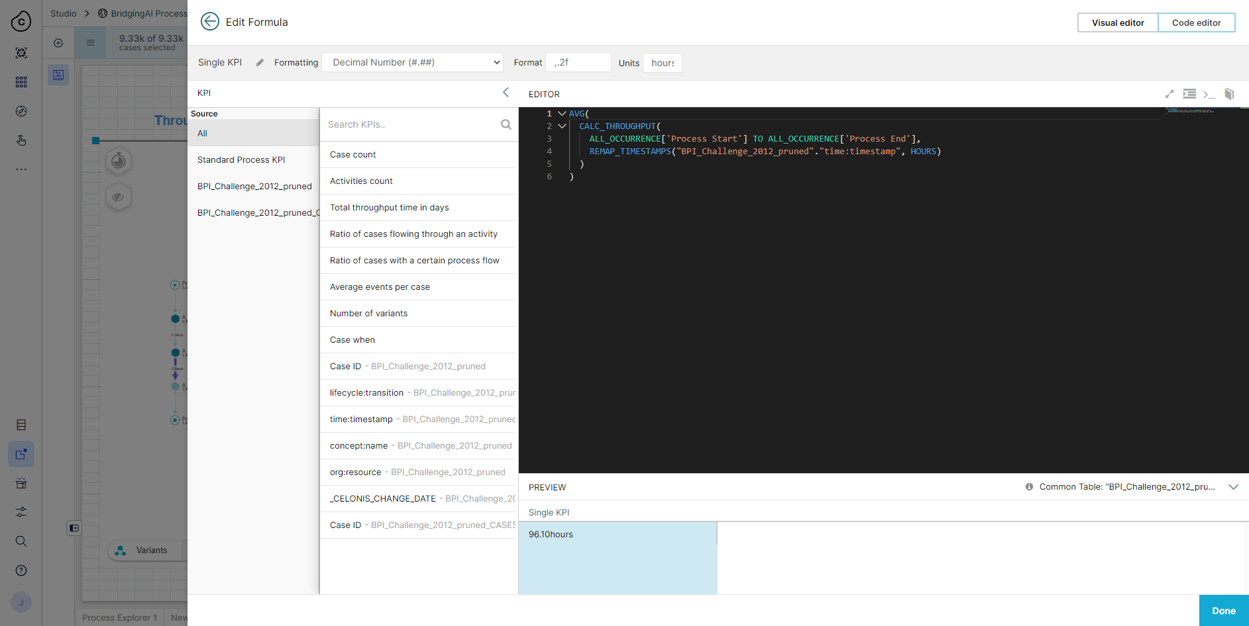
Solution – Exercise 2
Average throughput time

Slide 6

Solution – Exercise 2
Median throughput time

Slide 7

Solution – Exercise 2
Maximal time between consecutive activities

Slide 8
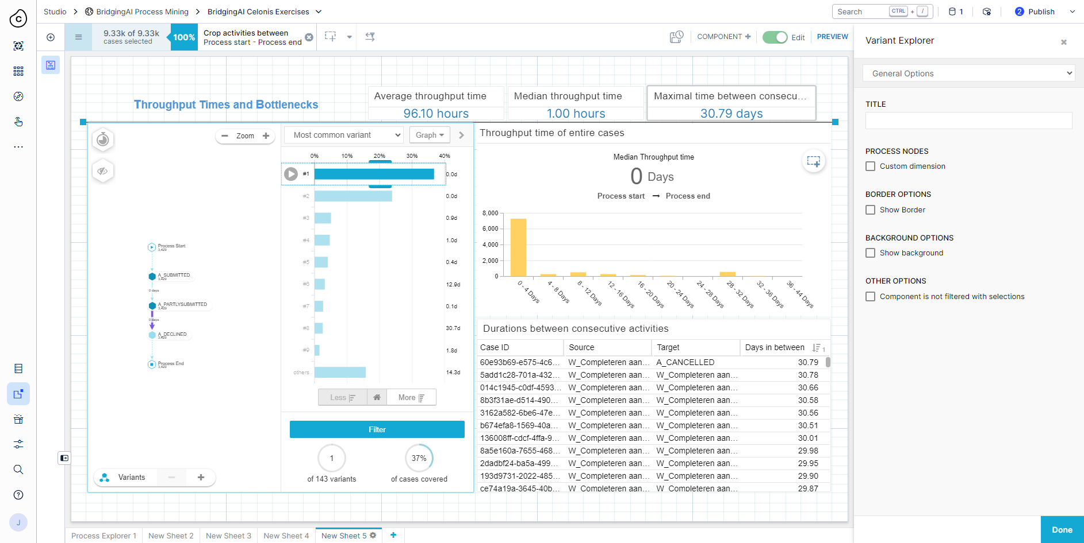
Solution – Exercise 2
Variant Explorer

Slide 9
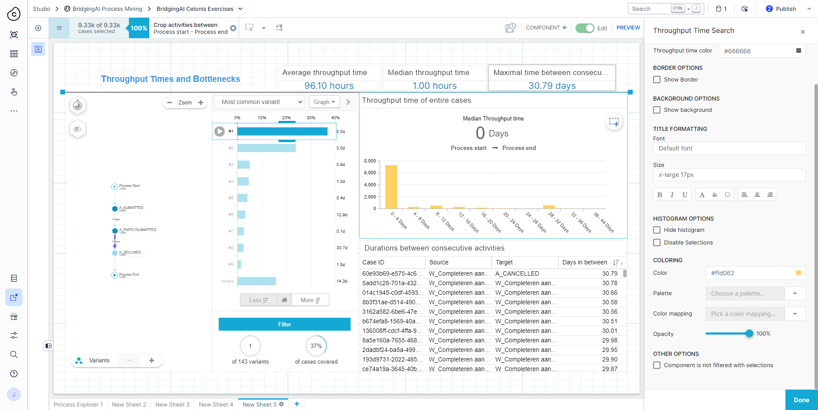
Solution – Exercise 2
Throughput Time Search

Slide 10
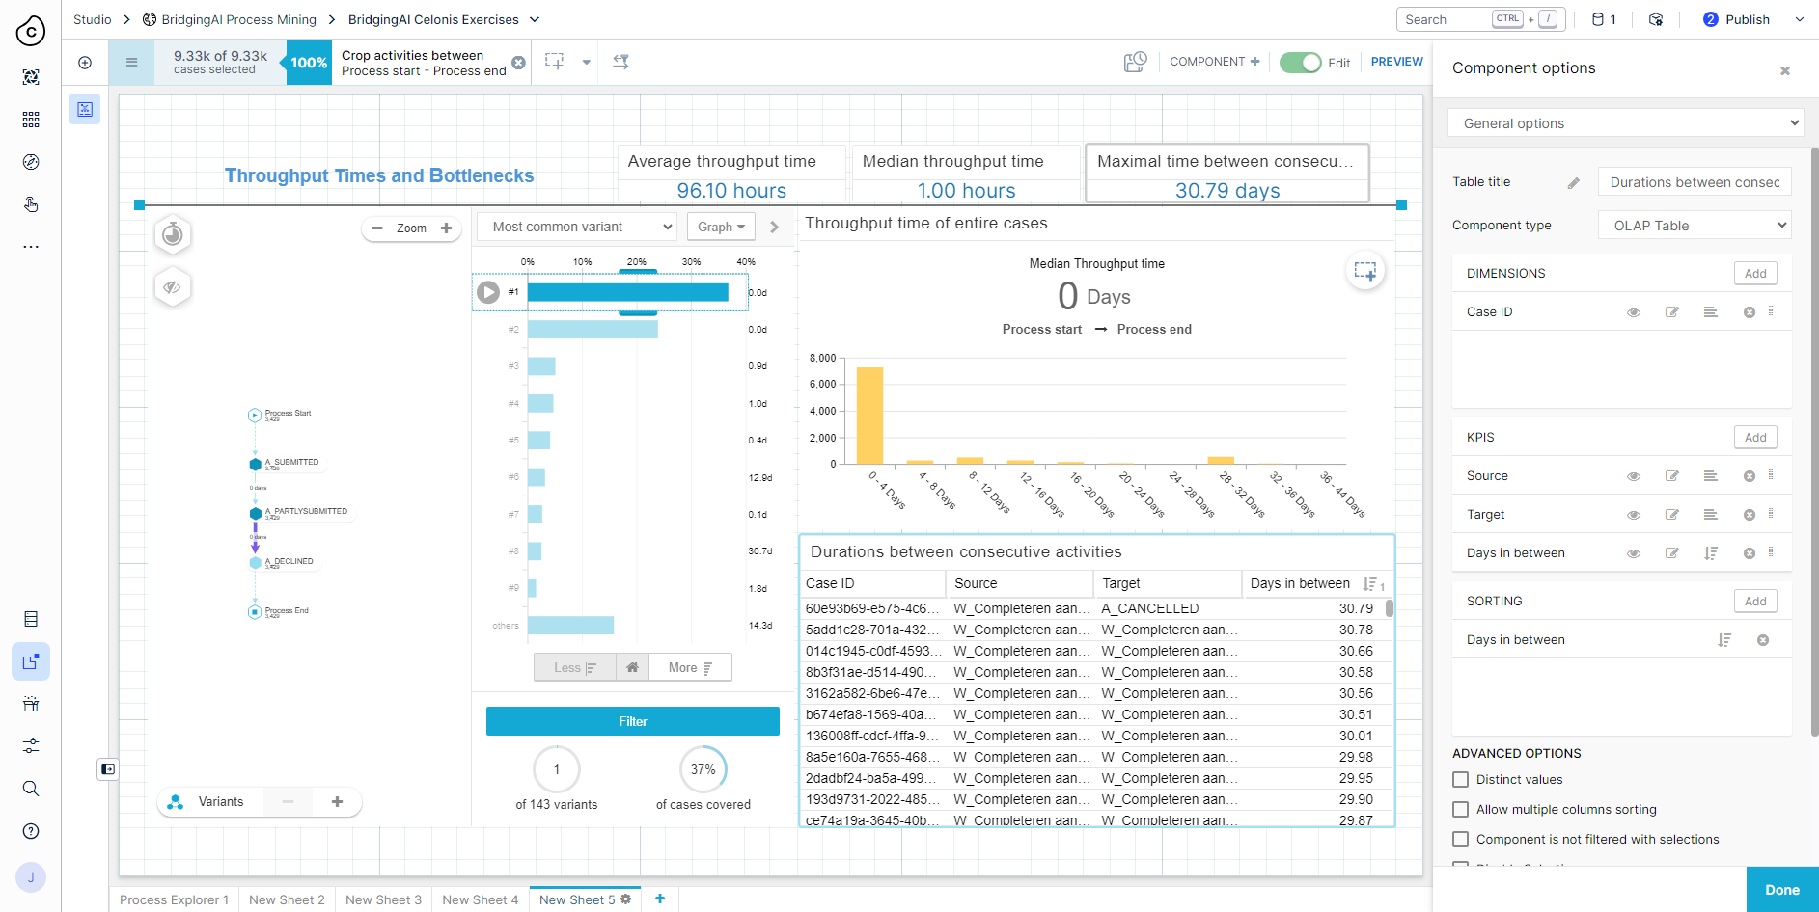
Solution – Exercise 2
OLAP table - Overview

Slide 11
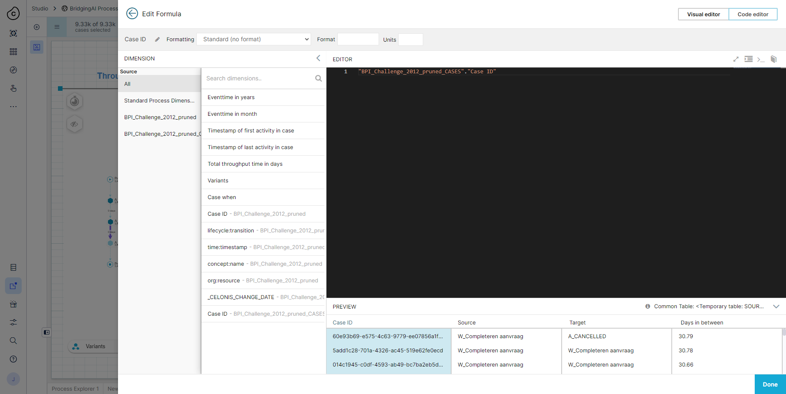
Solution – Exercise 2
OLAP table – Case ID (Dimension)

Slide 12
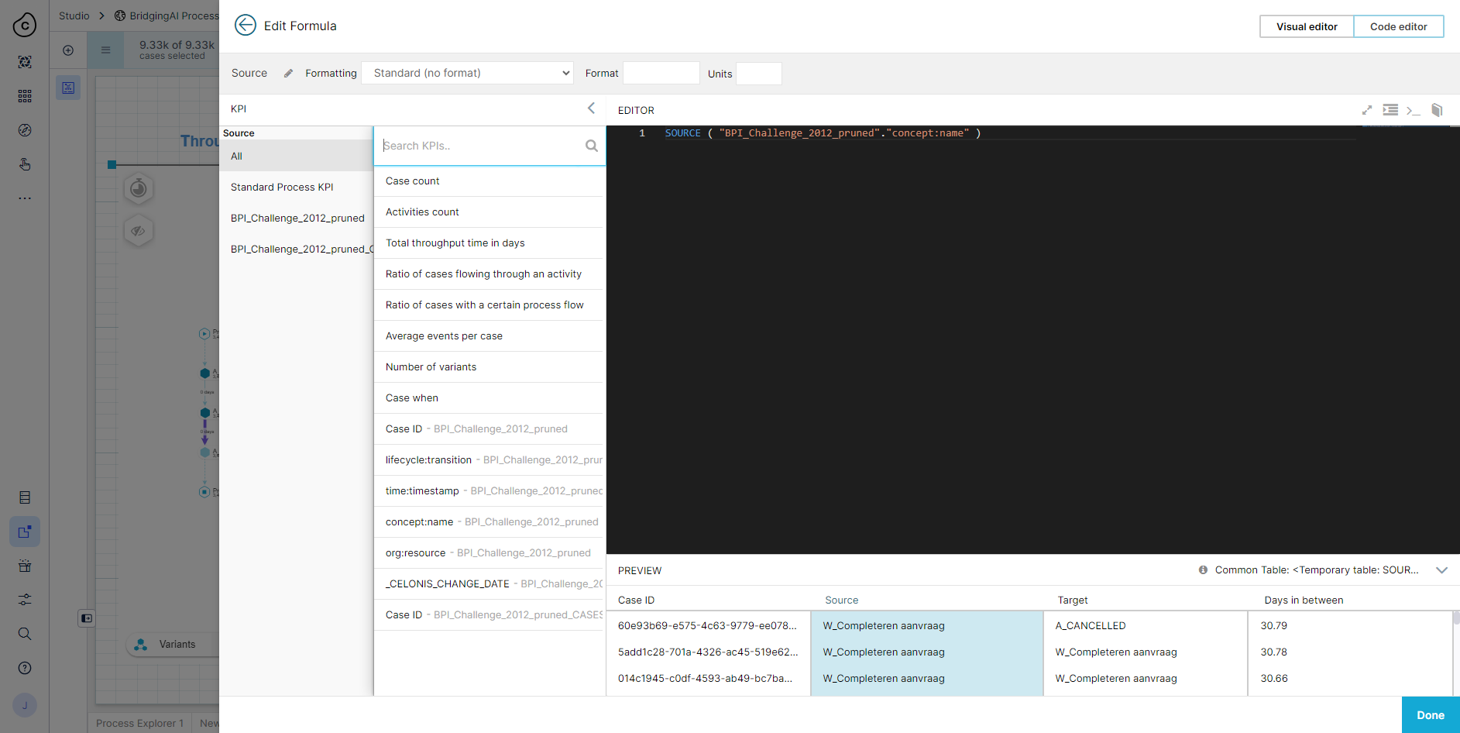
Solution – Exercise 2
OLAP table – Source (KPI)

Slide 13
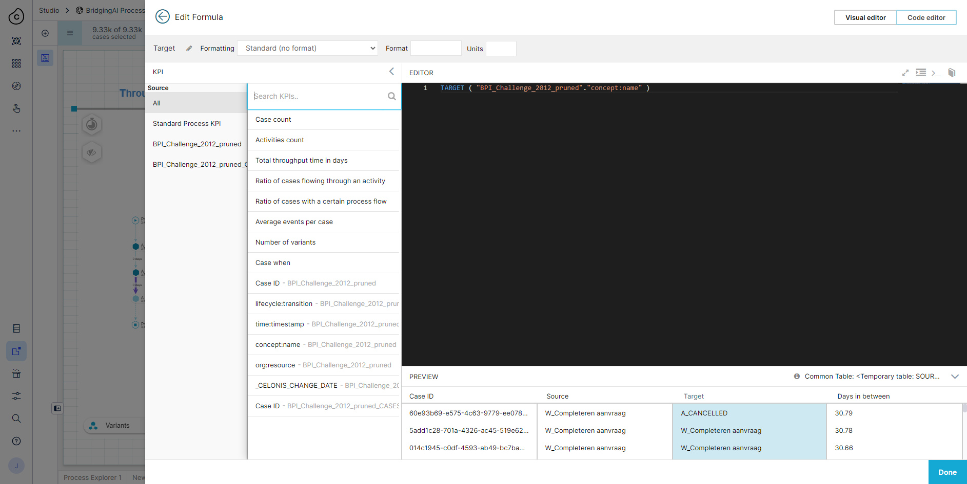
Solution – Exercise 2
OLAP table – Target (KPI)

Slide 14
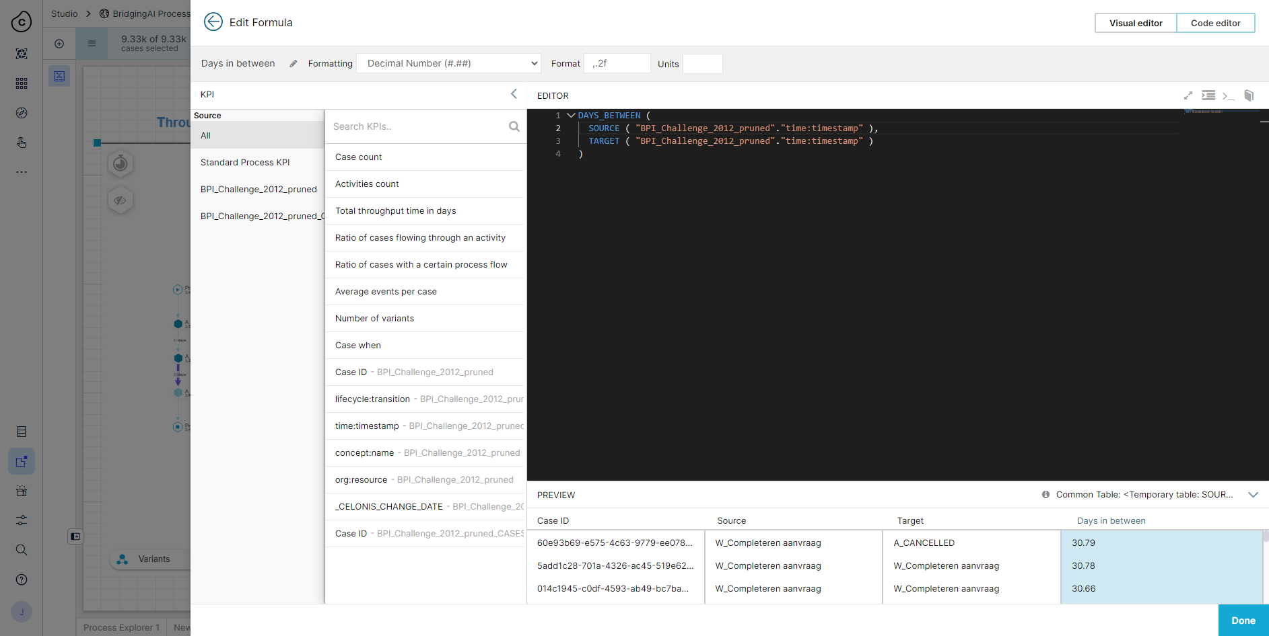
Solution – Exercise 2
OLAP table – Days in between (KPI)

